Slide 1
Classes

Slide 2
User defined types
We can define our own data types using
typedef - rename a type for easier reading
struct - used to group data
class - used to define objects

Slide 3
About typedef: (Put it under #includes)
Allows you to rename types
e.g.
typedef unsigned int myUint
typedef long long vLong
Everywhere you put your type name, the compiler inserts the actual. Like this:
vLong bigNum1, bigNum2;

Slide 4
Useful for Defining Pointer Types
Let’s define a pointer type:
typedef int* IntPtr;
Previously:
int * p;
Now:
IntPtr p;
Notes:
As a convention, we use capitals to start a pointer type name to differentiate them from other variables.

Slide 5
Advantage #1: clearer – can’t forget *
For 2 vars intended to be pointers:
int *p1, p2; // error. P2 not a ptr!
Clearer intent:
IntPtr p1, p2;
Both are pointers!

Slide 6
Advantage #2: clearer parameters
Pass a pointer to a function, by reference
void sample_function(int& *ptrVar);
Need * AND & // Ugly? Confusing?
void sample_function(IntPtr& ptrVar);
Only need the & !

Slide 7
Classes / Objects

Slide 8
What Is a Class?
A class is a type that is defined by a programmer to describe an object.
Have we used any classes already?
Yes, string!
string name; // name is a string object
name.length(); // length() is a member function

Slide 9
Classes
A class describes a set of objects all with the same behavior
The definition of a class includes
Member variables (or data members)
Member functions (or methods)
Class variables and functions (discussed later)
A class definition is like a structure definition except that members are private by default…

Slide 10
A Class Example: class DayOfYear
To create a new type named DayOfYear as a class
DayOfYear values are dates, like July 4 with no year
Decide on how to represent the values
Data member month is an int (Jan = 1, Feb = 2, etc.)
Data member day is also an int
Decide on the member functions needed
Start with one member function named output() that will print the month and day

Slide 11
Class DayOfYear Definition
class DayOfYear { public: void output( ); int month; int day; };
public label
Member Function Declaration
What do you see that’s different between this and our structs?

Slide 12
Struct vs Class – the true difference!
Structs have public data members and functions by default
Access ANY struct members directly with the ‘.’ (dot) operator:
cout << bday.month << “/” << bday.day;
Classes have private data members and functions by default. (not accessible)
Access ONLY the public class members with the ‘.’ (dot) operator
bday.output();

Slide 13
Class DayOfYear Definition
class DayOfYear { public: void output( ); int month; int day; };
Don’t forget this!
If you leave out the public keyword, everything is private
so you cannot access anything in the class

Slide 14

1
2
4
5
6
7
8
9
10
12
13
14
16
17
18
19
21
28
29
#include <iostream>
using namespace std;
// Class DayOfYear
class DayOfYear
{
public:
void output();
int month;
int day;
};
int main()
{
DayOfYear today;
// Set the object values
today.month = 10;
today.day = 16;
// Call member function
today.output();
return 0;
}
Just like a struct
Define DayOfYear class type
Declare an object
Set the data members
Call the member function
Notes:
Note: I simplified the code and strategically shrunk less important lines of code so I could make the most relevant text bigger, I highlighted the different blocks (adding delayed onset of highlights using animations), and made the account.term=6, which is easier to compute as half a year (6 months).

Slide 15
Member Function Definition
void DayOfYear::output()
{
cout << "month = " << month << ", day = " << day << endl;
}
Remember that when we called output() the code was
today.output();
The member function has access to today’s data members.
output() is part of DayOfYear
But which month?

Slide 16
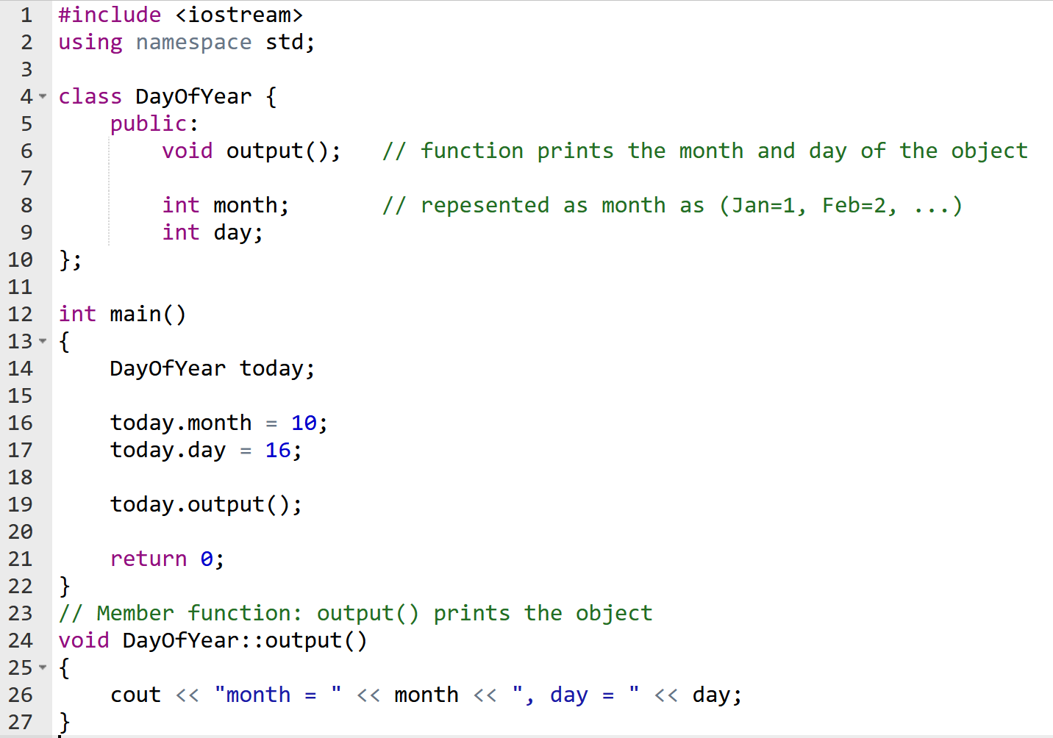
A complete program
Class definition
Variable today is an object
Call output() with today object
When output() runs, month is
today.month

Slide 17
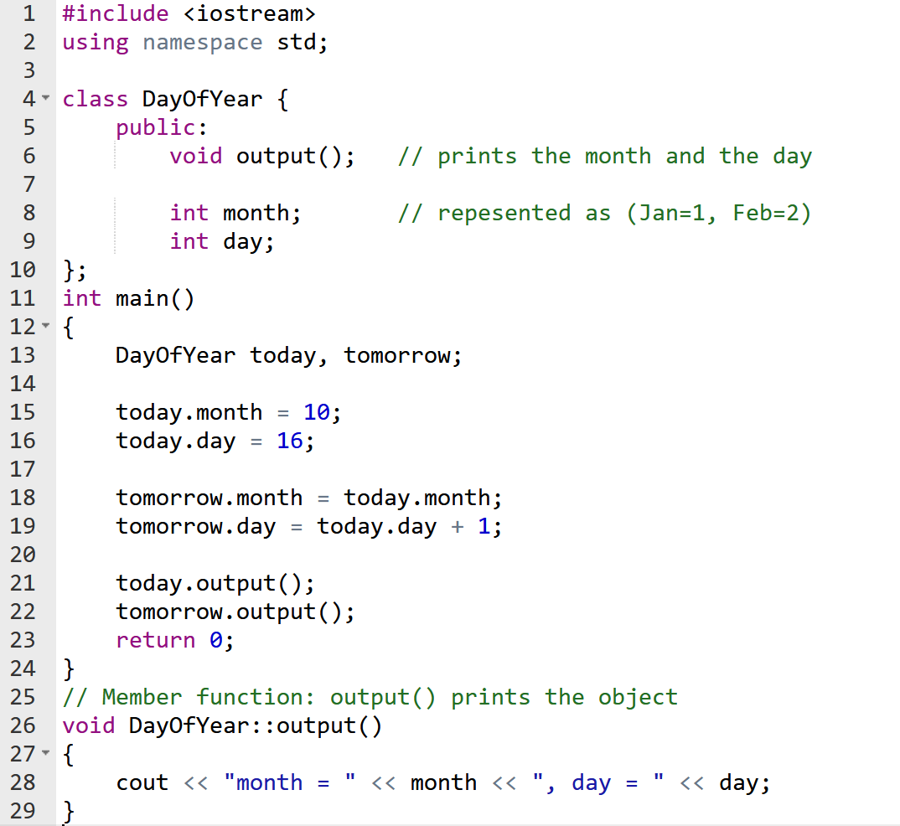
Object memory
Stack
today
month | 10
day | 16
tomorrow
month | 10
day | ?
When tomorrow.output() runs, month is tomorrow.month

Slide 18
‘::’ and ‘.’ operators
:: <classname> :: <memberfunction> void DayOfYear::output( ) // definition { // function body
}
. <classname>.<function> (to call the member function)
DayOfYear birthday; birthday.output( );// . (dot) to call

Slide 19
Scope resolution operator ‘::’
Identifies the class the member function belongs to
void DayOfYear::output( ) indicates that function output is a member of the DayOfYear class
We only use ‘::’ operator outside of the class never inside of the class definition

Slide 20
Where is the scope operator?
The scope ‘::’ operator is used only here
Notes:
Why down here? Usually we put the function definitions in another place just like ordinary function prototypes at the top and definitions after main.

Slide 21
Let’s improve our class
Is there anything to prevent a programmer from accidently setting an illegal DayOfYear?
today.month = 49; today.day = 81;
How can we prevent errors ?
Take away direct access to data members (the .)
Add helper functions
For validation
To access and modify the values

Slide 22
1. Making some parts private
private members of a class can only be referenced by
this class’s member functions
How do we make this happen?

Slide 23
Previously today.month = 49;
class DayOfYear
{
public:
void output();
int month;
int day;
};
void DayOfYear::output() // don’t need these m & d
{
cout << "Month: " << month << " Day: " << day << endl;
}

Slide 24
1. Make some parts private
Now, from main, this gives a compiler error:
today.month = 49;
class DayOfYear
{
public:
void output();
private:
int month;
int day;
};
void DayOfYear::output() // don’t need these m & d
{
cout << "Month: " << month << " Day: " << day << endl;
}

Slide 25
2. Add helper functions
To set values
And check that they are OK
To get values
How do we make this happen?

Slide 26
2. Helper functions – public
Now, from main, this gives a message, but won’t set a bad month:
today.setMonth(49);
49 is a bad month!
class DayOfYear
{
public:
bool setMonth(int m);
void output();
private:
int month;
int day;
};
bool DayOfYear:: setMonth(int mo) {
if((mo > 0) && (mo <=12)) {month = mo; return true;}
else { cout << mo << “is a bad month!” << endl;
return false;}
}

Slide 27
Ideal DayOfYear class has: setters & getters
Public Member functions :
set(int month, int day) // a ‘setter’
get_month()
get_day()
output()
input() //We can define input() later
Private Member function:
verify_date(); // returns true if date is OK
// perhaps called by the set(int month, int day) function
}
‘getters’

Slide 28
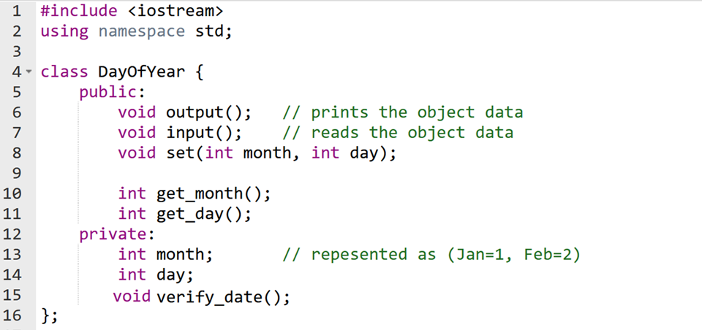
Better DayOfYear class Definition
public member functions
private data members and utilities

Slide 29
Reviewing: Using Private Variables
It is normal to make all member variables private
Private variables require public member functions:
Accessors (getters)
Mutators (setters/changers)

Slide 30
Accessors: Get Private Variables
Public member functions that allow us to get the values of private data members
Example:
int DayOfYear::get_month()
{ return month; }
int DayOfYear::get_day()
{ return day; }

Slide 31
Mutators: Set Private Variables
Public member functions that allow us to set/change the values of private data members
Example:
void DayOfYear::set(int new_month, int new_day)
{
month = new_month; day = new_day;
}
Notes:
Let’s fix this to protect against bad data.

Slide 32
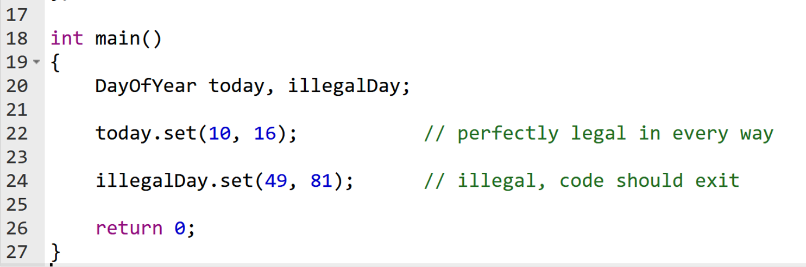
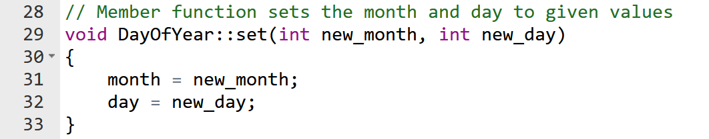
Sample DayOfYear program
// Does this code protect against bad data?
Notes:
Let’s fix it!

Slide 33
Public or Private Members
The keyword public identifies the members of a class that can be accessed from outside the class in your program.
Members that follow the keyword public are public members of the class (can be accessed by anyone)
The keyword private identifies the members of a class that can be accessed only by member functions of the class (can only be accessed by class)
Members that follow the keyword private are private members of the class

Slide 34
Calling a class’s member function
Example:
DayOfYear due_date;
Due_date.set(11, 19);
---
Remembering the definition:
void DayOfYear::set(int new_month, int new_day)
{
month = new_month; day = new_day;
}
Notes:
Draw the picture on the board.

Slide 35
The Assignment Operator
Objects and structures can be assigned values with the assignment operator (=) but cannot compare with operator (==)
Example:
DayOfYear due_date, tomorrow;
tomorrow.set(11, 19);
due_date = tomorrow; // perfectly legal
if (due_date == tomorrow) // illegal!
cout << “^^^ Won’t compile!”;
Notes:
Draw the picture on the board.

Slide 36
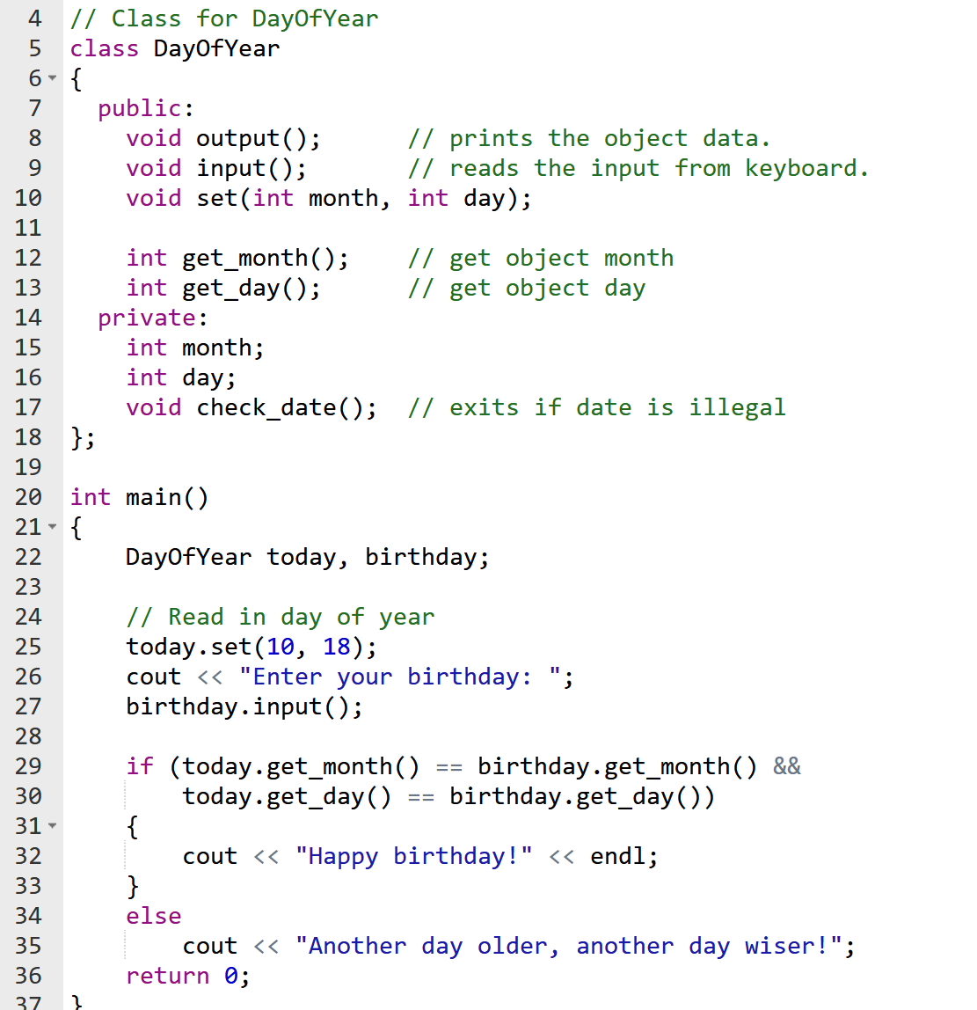
How you might compare two DayOfYear Objects

Slide 37
== testing is pretty common let’s make a member function INSIDE our class to do this

Slide 38
Let’s call it: isEqualTo( )
Return value?
Where should it go?
public or private?
Why?

Slide 39
So how can we write this …. properly?
We want to say: if ( today == birthday )..
It might be called like this:
if ( today.isEqualTo( ? ) )
And the declaration:
bool isEqualTo( ) ;
// so, what is the parameter?
We can pass an object as a parameter!

Slide 40
So how can we write this…. properly?
We want to say: if ( today == birthday )..
It will be called by:
if ( today.isEqualTo( birthday) )…
And the declaration:
bool isEqualTo(DayOfYear doy ) ;
How can we write the code?

Slide 41
Define isEqualTo for DayOfYear class
Code?

Slide 42
bool isEqualTo method DON’T FORGET TO SCOPE IT! (::)
bool DayOfYear::isEqualTo(DayOfYear doy)
{
if (month == doy.get_month() &&
day == doy.get_day())
return true;
return false;
}
Somewhat better though….

Slide 43
A little better isEqualTo
bool DayOfYear::isEqualTo(DayOfYear doy)
{
if (get_month() == doy.get_month() &&
get_day() == doy.get_day())
return true;
return false;
}
// Presumably get_month() has more protections

Slide 44
Terms
From an object:
Calling a function
Invoking a function
Are the same thing

Slide 45
The magic this pointer
The compiler associates the name this with the address of the current object - for every fcn & var
Suppose we have DayOfYear today;
Like an extra (invisible) parameter. Think of it this way:
today.input(); // Compiler translates as input(&today);
//and in the definition
void DayOfYear::input() // as void input(DayOfYear* this)
{
cin >> month; // which translates to
// cin >> this->month

Slide 46
Remember DayOfYear
DayOfYear today, TaylorS_birthday;//Swift
today.input();
cout << “You entered “ ;
today.output();
TaylorS_birthday.set(12, 13);// Dec 13
Let’s say our output was:
You entered Month = 10 Day = 21

Slide 47
Using the magic this pointer
bool DayOfYear::isEqualTo(DayOfYear doy)
{
return (this->month == doy.month &&
this->day == doy.day);
}
// Why does this work?
if (today.isEqualTo(TaylorS_birthday))
cout << “Today is Taylor Swift’s Birthday\n”;
// C++ assigns this = &date (because of the ‘.’ operator
// in the function call above) behind the scenes.
isEqualTo stack
this->month | 10
this->day | 18
doy.month | 12
doy.day | 13

Slide 48
Remember DayOfYear
DayOfYear today, TaylorS_birthday;//Swift
today.input();
cout << “You entered “ ;
today.output();
TaylorS_birthday.set(12, 13);// mo, day
What if we wanted to initialize TaylorS_birthday at declaration time?

Slide 49
We Can! Called a Constructor
Same name as class. No return type
class DayOfYear
{
public:
bool setMonth(int m);
void output();
DayOfYear (int m, int d); // use params when created
private:
int month;
int day;
};
//Definition
DayOfYear::DayOfYear(int m, int d)
{
month = m;
day =d;
}
// now declare & init all in one!
DayOfYear TaylorS(12,13);

Slide 50
What if we just want the object – no outside initialization?
Called a Default Constructor. No Params
class DayOfYear
{
public:
bool setMonth(int m);
void output();
DayOfYear ( ); // no params when created
private:
int month;
int day;
};
//Definition
DayOfYear::DayOfYear( )
{
month = -1; // optional
day = -1; // & indicates
//that it’s not set
}
DayOfYear mysteryDay; // has -1 vals for month & day

Slide 51
What if we just want the object – and left out the default constructor ?
Called a Default Constructor. No Params
class DayOfYear
{
public:
bool setMonth(int m);
void output();
// DayOfYear ( ); // default w/no definition written
private:
int month;
int day;
};
//Definition
DayOfYear::DayOfYear( )
{
} // don’t bother
DayOfYear mysteryDay2; // has garbage vals for month & day

Slide 52
Overloading Constructors

Slide 53
Overloading Constructors
A class can have more than one constructor
Overloaded constructors in a class must have different parameter lists:
DayOfYear();
DayOfYear(int m);
DayOfYear(int m,int d);

Slide 54
Default values in Constructors
If all of a constructor's parameters have default values, then it is a default constructor. Done in declaration. For example:
DayOfYear(int month=1, int day=1);
Creating an object and passing no arguments will cause this constructor to execute: DayOfYear newYear; // Initialize 1/1
DayOfYear rentDue(4), today(3, 25);

Slide 55
Default constructor provided only…
If your program does not provide any constructor for a class defined by you, C++ generates a default constructor for you that does nothing.
If your program provides any constructor (maybe only one), but no default constructor, C++ does NOT generate a default one.

Slide 56
Review

Slide 57
Review
What’s the difference between structs vs classes?
What does public: mean? What does private: mean?
What do we put in the public vs private parts of class?
What syntax do we use to say a function definition is for a class member function?

Slide 58
So far…
What’s the difference between structs vs classes?
Structs are public by default
Classes are private by default
What does public: mean? What does private: mean?
Public means everything following is accessible anywhere
Private means only accessible in the class member functions
What do we put in the public vs private parts of class?
Member functions go in the public part
Data members and utilities go in the private part
What syntax do we use to say a function definition is for a class member function?
We scope it as ClassName::functionName()

Slide 59
So far… continued
What is an accessor and what is a mutator and how can we tell them apart?
What is the name of the implicit parameter in class member functions and how does it get assigned?

Slide 60
So far… continued
What is an accessor and what is a mutator and how can we tell them apart?
An accessor is a function that accesses values in the object
A mutator is a function that changes values in the object.
Accessors are getter and Mutators are setter functions
What is the name of the implicit parameter in class member functions and how does it get assigned?
Invoking or calling object is the implicit parameter
The address is assigned to the this pointer

Slide 61
Constructors
Member function that is automatically called when an object is created
Purpose is to construct an object
Constructor function name is the class name
Has no return type or return statement.

Slide 62
Default Constructors create objects
If you write a class with NO constructor, C++ provides a default constructor for you that does nothing.
A default constructor is a constructor that takes NO arguments. BUT can still do something.
Declaring an object of class type (simple instantiation) calls the default constructor:
DayOfYear today; // default constructor called

Slide 63
Passing Arguments to Constructors
To create a constructor that takes arguments:
indicate parameters in prototype: DayOfYear(int m, int d);
Use parameters in the definition: DayOfYear::DayOfYear(int m, int d) { month = m; day = d; }

Slide 64
Passing Arguments to Constructors
You can pass arguments to the constructor when you create an object:
DayOfYear today(3, 25);

Slide 65
Classes with No Default Constructor
When all of a class's constructors require arguments, then the class has NO default constructor.
When this is the case, you must pass the required arguments to the constructor when creating an object.

Slide 66
Overloading vs Default values
Default values when the code is the same independent of the number or type of parameters
Overloaded constructors when different:
Rectangle(); Rectangle(double w);
Rectangle(double w, double h);
OR
Rectangle(double w=1.0, double h=1.0);

Slide 67
Abstract Data Types
Classes to Produce Abstract Data Types
Interface and Implementation Files
Using Include Guards
Data types where the programmers using the type don’t know how the values and operations are implemented.
Notes:
Data types are not JUST values - they are the values combined with sets of basic operations defined on those values. So an int is not just, say, 5. It’s also the math operations we perform on them. One key thing about these built-in data types - we don’t really know how it is implemented. We don’t NEED to know, and even if you did, you wouldn’t use that information in a C++ program. They are examples of abstract data types.
Now, these abstract types are pretty intuitive, perfectly following the idea of procedural abstraction - we know what they do and how to use them without concerning ourselves with the details. Ideally, we want our own classes to work like that. It’d make them way easier to plug in and use in multiple contexts. We’ll need to design our classes in specific ways, but making our classes into ADTs makes them more intuitive and easier to modify.
IN LAB: Write the alternative implementation of the BankAccount class.

Slide 68
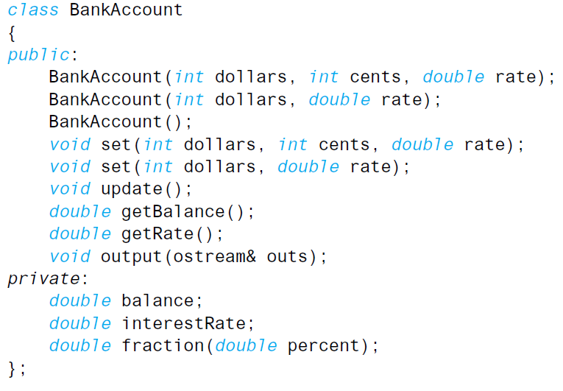
Classes to Produce Abstract Data Types
We’ll be using this class for the following examples:
Notes:
This is the BankAccount class that we wrote in lab! Everything we wrote there applies here.

Slide 69
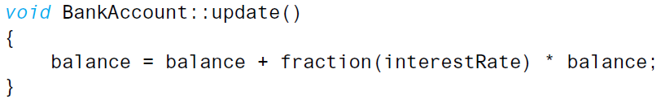
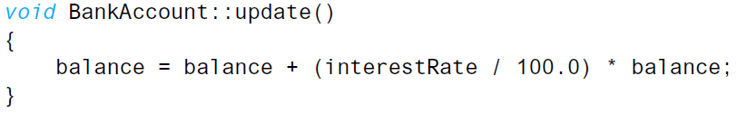
Classes to Produce Abstract Data Types
Programmer2, who uses your BankAccount class does not need to know the particulars of how you implemented any one member function.
For example, both of these two update functions would work equally well:
They both have the same effect - so why would Programmer2 need to know the particulars?
Notes:
So let’s discuss how procedural abstraction would apply for a class.

Slide 70
Classes to Produce Abstract Data Types
Programmer2 also does not need to know how the values of the class are implemented.
For example, an instance of BankAccount, say, vacationSavings, does have two values of type double:
vacationSavings.balance
vacationSavings.interestRate
Ideally, Programmer2 will be thinking of the object as a single entry, not as its individual components. The use of doubles would be an implementation detail.

Slide 71
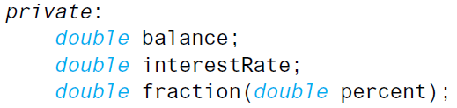
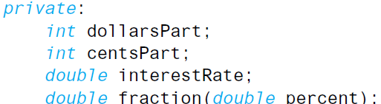
Classes to Produce Abstract Data Types
For example, the balance could have theoretically been represented with two ints (dollars and cents) instead of a double:

Slide 72
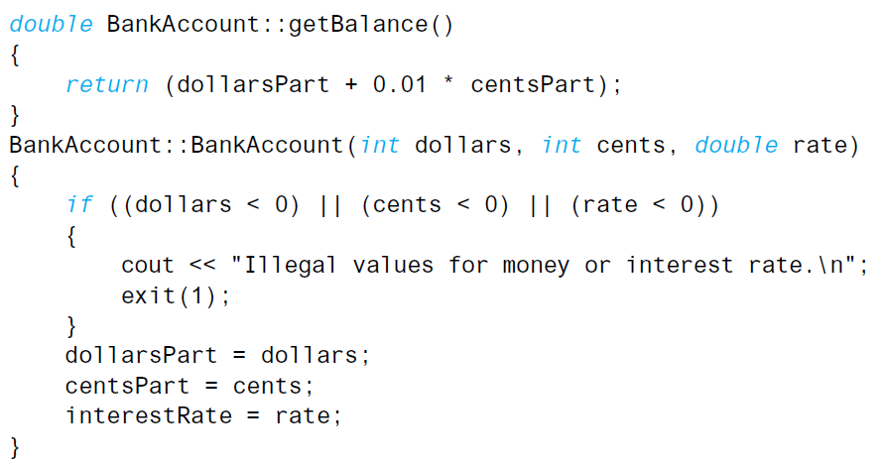
Classes to Produce Abstract Data Types
You WILL need to change your member functions and constructors, for instance…
...but the programmer using the type BankAccount need not be concerned with the exacts - just how to declare and use objects.

Slide 73
Classes to Produce Abstract Data Types
Benefits of ADTs:
ADTs are more reusable between multiple programs
Programmer2, using your ADT only needs to know how to declare and use objects to use your class.
You can change the implementation of your class without changing the other parts of your program.
You can divide your work - one programmer can make and design the ADT, and the other can write the program using the ADT.
Alternatively, it lets you subdivide the work for solo work - making the class independent of the program, and making the program that uses the class.

Slide 74
Interface and Implementation Files
To define a class to make them abstract data types, you need to separate the specifications of how the type is used from the details of how the type is implemented. Follow these three basic rules:
Make all the member variables private members of the class.
Make each of the basic operations that the programmer needs a public member function of the class, and fully specify how to use each such member functions.
Make any helping functions private member functions.
Notes:
These aren’t the only approaches - we’ll go over more in the coming chapters.

Slide 75
Interface and Implementation Files
Interface: Tells you how to use an ADT in your program.
Member variable declarations
Public Member Functions + Comments that tell you how to use them.
This should be the only thing required to use an ADT.
Implementation: Tell you HOW the ADT is realized in C++ code.
Definitions of public and private members functions.
Notes:
The interface is the public scope of your program, essentially.
Again, this is that black box/procedural abstraction idea in practice. If you’ve written a good ADT, a programmer should know how to use the class, but they don’t need to know the particulars of HOW it works.

Slide 76
Interface and Implementation Files
Place the interface and implementation into separate files
Interface File - .h
Implementation File - .cpp
Then the driver (which includes main)
Driver.cpp
Notes:
Now, a quick aside, since we’ll be covering this in a later class - in practice, you’ll be separating your interface and implementation into separate files - a .h for the interface and a .cpp for the implementation - and separating both out from the rest of your code. For now we’ll still include it in the same file as our main function, but begin to write your stuff with this implementation in mind.

Slide 77
Interface and Implementation Files
For the BankAccount class:
bankAccount.h
bankAccount.cpp
Then the driver (which includes main) bankAccountDriver.cpp
Notes:
Now, a quick aside, since we’ll be covering this in a later class - in practice, you’ll be separating your interface and implementation into separate files - a .h for the interface and a .cpp for the implementation - and separating both out from the rest of your code. For now we’ll still include it in the same file as our main function, but begin to write your stuff with this implementation in mind.

Slide 78
Interface and Implementation Files
The interface (.h) file, or header file, contains ONLY the class definition - no implementations. You can still have include and using directives.
Notes:
Note that, of course, you should also make sure to include comments describing all of the functions and such.

Slide 79
Interface and Implementation Files
The implementation (.cpp) file contains all of the function definitions. However, it also features an include directive to the .h file:
#include "bankAccount.h"
This imports all of the definitions of the file into the .cpp file, allowing them to be used.

Slide 80
Driver File
The rest of the program code is contained in its own .cpp file, often called the driver or application file
The driver is responsible for all non-class functions (including main)
This file should also #include any .h files.
Notes:
So long as all of the files are included in the same folder, this will be covered.

Slide 81
Compiling
First, ensure that they are all in the same folder/directory
For g++, list each class implementation file, and the driver:
g++ bankAccount.cpp bankAccountDriver.cpp -o bank.out
No need to mention the header files - the include directives cover that
Notes:
So long as all of the files are included in the same folder, this will be covered.

Slide 82
Using Include Guards
Larger programs often use multiple classes, many of which have an include directive to the same file.
#include "bankAccount.h "
Because of this, multiple files can contain the definitions more than once, which can cause compilation errors.
By having include guards in your header files, you can avoid this situation - these will prevent them from being defined again if they were previously defined.
Notes:
This is something that is okay when working with just a single class and a driver, but it becomes a problem with multiple classes.

Slide 83
Using Include Guards
#ifndef <NAMEOFCLASS>_H: Checks to see if a class has not been defined. If it hasn’t, do everything between it and #endif
#define <NAMEOFCLASS>_H: “Defines” the class.
For bankAccount.h:
#ifndef BANKACCOUNT_H
#define BANKACCOUNT_H
< class definition here>
#endif
Notes:
Thankfully, using include guards is super simple.

Slide 84
Discuss structures to store Student Info
Info about a student?
Name
ID
Start Date
Major
Minor
Data for each of these?
What else?

